Slide 1

XYZ G2M Analysis
Name: Hazim Bukhari

Slide 2
Introduction
Business Problem?
Help XYZ make a final decision on which cab company to invest in.
Data:
Dataset contains data about Two companies Yellow Cab and Pink Cab.

Slide 3
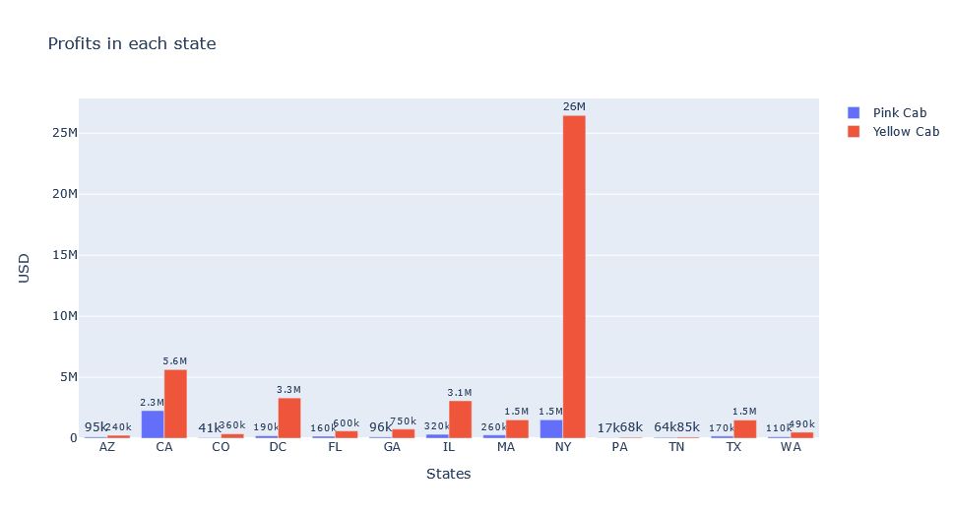
Profits per State
-Yellow Cab outperforms Pink Cab in every State.
-Yellow Cab made the most profit in NY state, and least profit in PA state.

Slide 4
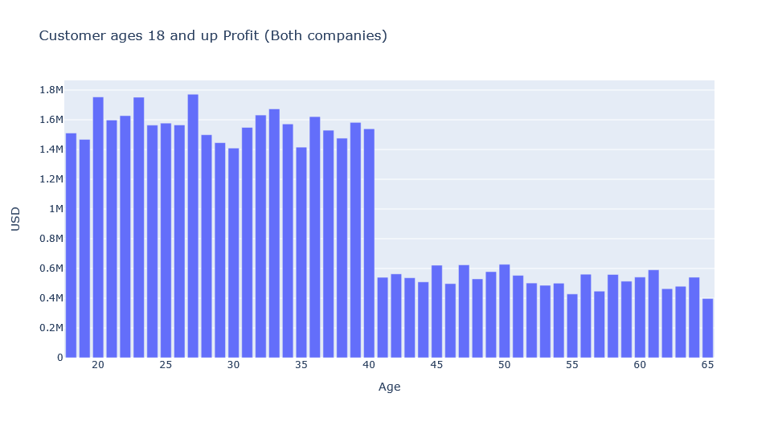
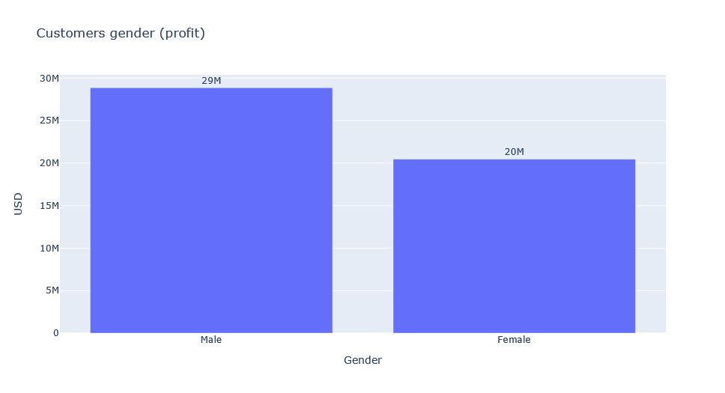
Customers Ages
- The most profit comes from customers ages between 18 to 40 years old.
- Male customers bring in about 58% of the profit.

Slide 5
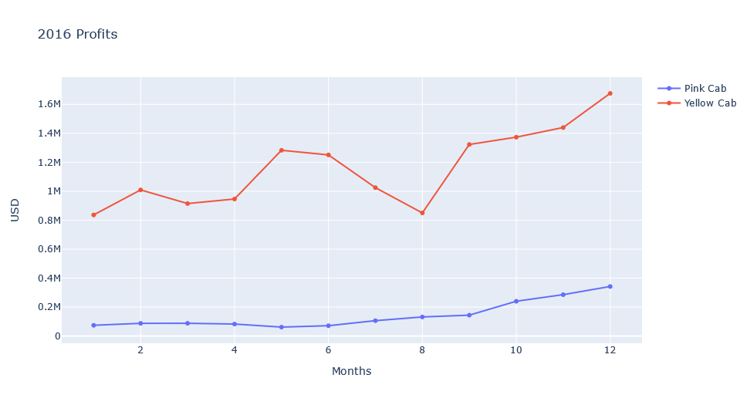
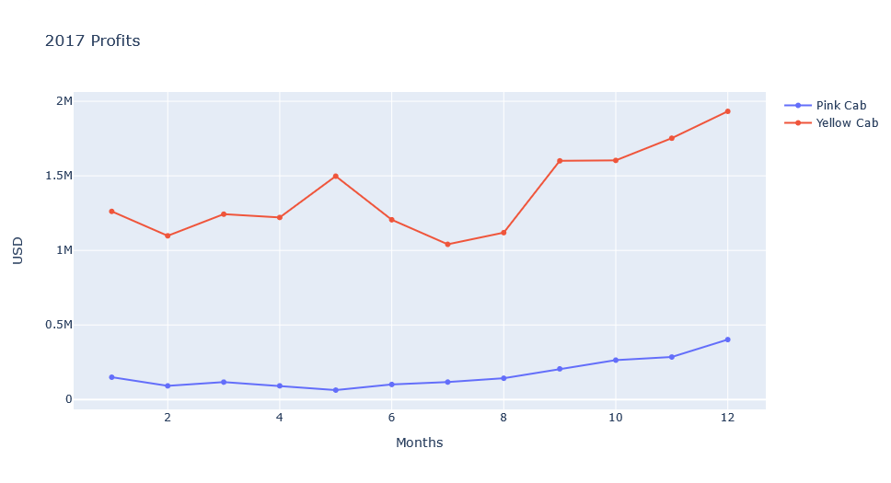
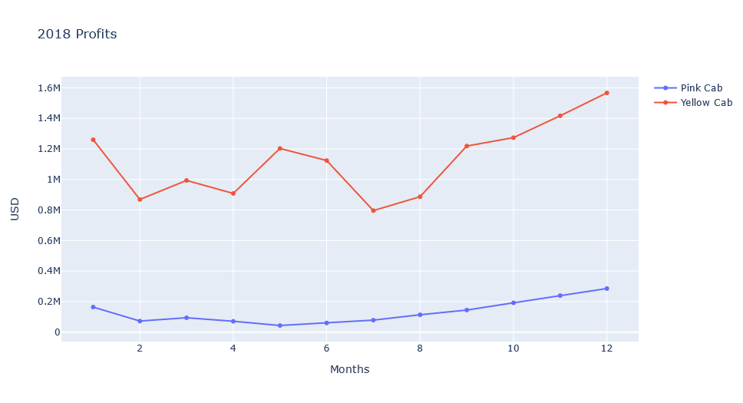
Profits per Year
-Yellow Cab experience a dip in profits from May to Aug.
-Both companies experience a rise in profit after Aug with a peek in Dec.

Slide 6
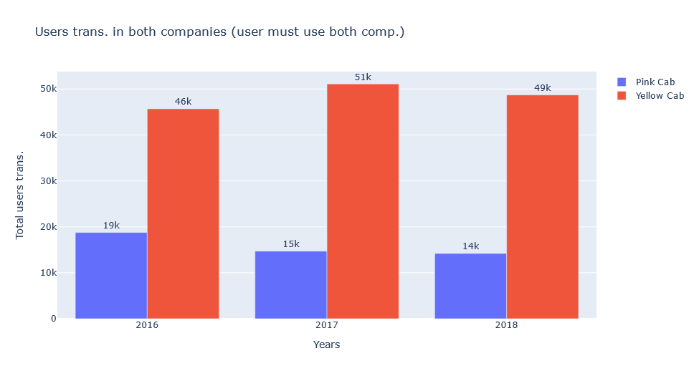
Customers Usage
- Users who uses both companies makes more transactions with Yellow Cab than Pink Cab.
- Some users stop making transactions with Pink Cab the next year as evident by the declining transaction each year.

Slide 7
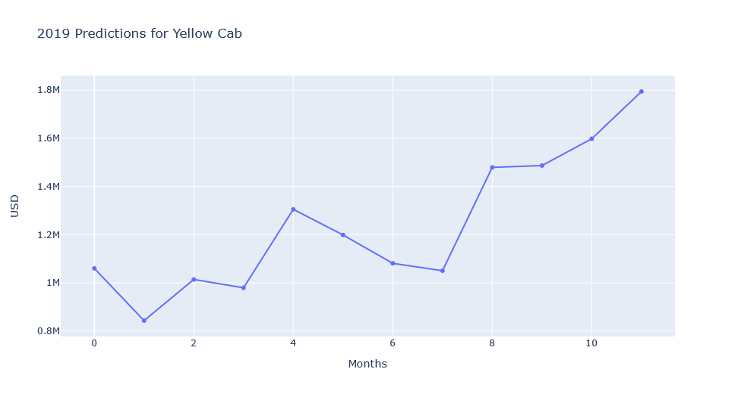
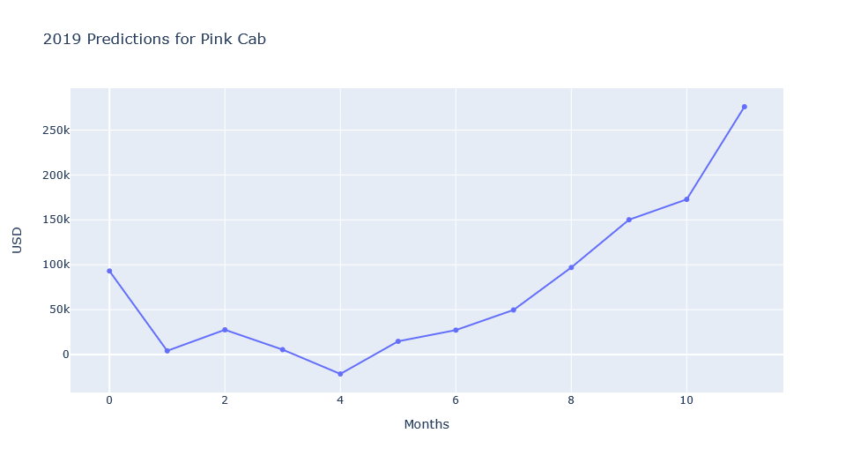
2019 Forecasting

Slide 8
Conclusion
Yellow Cab is the best option to invest in based on the following reasons:
Yellow Cab dominate Pink Cab profit wise in each state they operate in.
Yellow Cab makes as much as 8 times the profit of Pink Cab each year.
Users who use both companies stop or make less transactions with Pink Cab in favor of using Yellow Cab.

